Slide 1
Viral Prediction Using Machine Learning
Predicting Social Media Virality with AI

Slide 2
The Subject :
Social Media

Slide 3
Problem Statement
Objective
The Problem
Vs
Build a supervised ML model that predicts:
Viral (1) or Not Viral (0)
Only a small percentage of posts go viral
Virality is unpredictable
Marketing decisions rely on guesswork

Slide 4
Dataset Overview
Engagement metrics
Structure
Structured tabular dataset
Dataset Characteristics
Content
Engagement metrics
Type
Posting metadata
Output
Target variable:
Viral (binary)

Slide 5
Supervised Learning
01
02
Classification
Regression
Output: A specific numerical value
Output: Labels or classes

Slide 6
Exploratory Data Analysis (EDA)
Machine learning
Feature Selection
04
Saturn is the gas giant that has rings
Determining which variables influence the outcome.
Handling Missing Data
03
Deciding whether to fill in or delete rows
Checking Assumptions
02
Ensuring the data meets the requirements for algorithm
Patterns and Anomalies
01
Identifying trends or outliers

Slide 7
Handling Class Imbalance
Problem :
Viral posts = minority class
Solution :
SMOTE (Synthetic Minority Oversampling Technique)
Library Used
imblea

Slide 8
Machine Learning Models
Random Forest
XGBoost
Logistic Regression
builds trees sequentially each new tree is designed to fix the errors made by the previous trees
predicts the probability of an input belonging to a specific category
ensemble model that builds multiple decision trees and merges them together
Bagging (Random Forest)
Boosting (XGBoost)
reduces bias (the model learns to represent complex patterns that a simple line cannot).
reduces variance (the model won't change drastically if the data changes slightly)

Slide 9
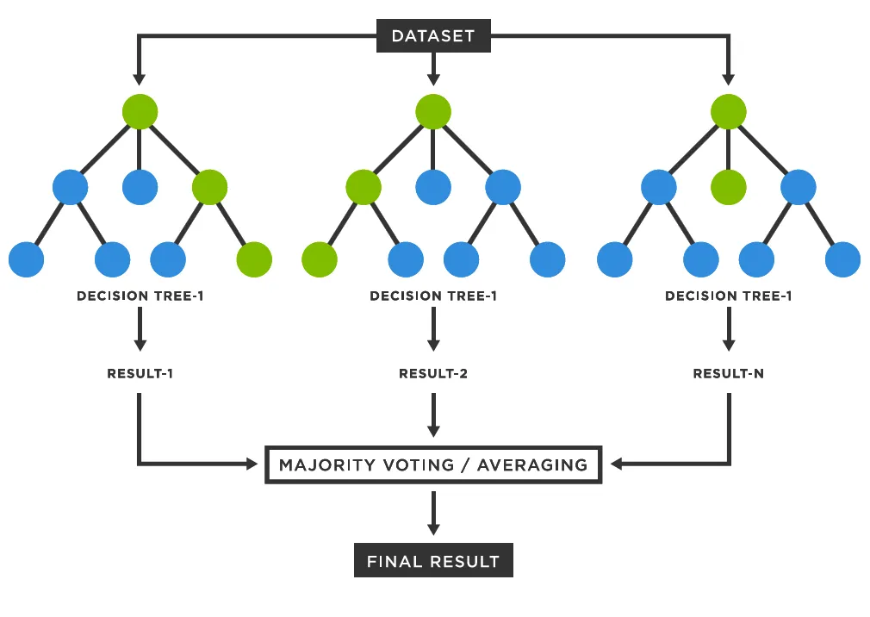
Random Forest
Random Forest aggregates multiple decision trees trained on different subsets of the data to improve generalization
Ensemble learning
Bagging
Reduces variance
Handles non-linear relationships

Slide 10
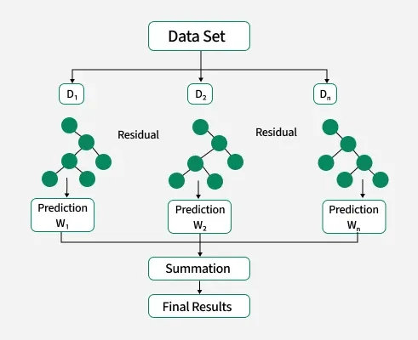
XGBoost
(Final Model)
XGBoost builds trees sequentially, correcting previous errors using gradient descent optimization, which makes it extremely powerful for structured datasets.
Gradient boosting
Sequential learning
Built-in regularization
High performance on tabular data

Slide 11
The Core of The Project
01 | DataSet Cleaner
02 | Model Training with XGBoost
03 | Apply Target Encoding for Categorical Variables
04 | Overview and testing
05 | Conclusion

Slide 12
Machine Learning Infographics
01
Classify data
Mercury is the closest planet to the Sun
Machine learning objectives
02
Make predictions
The Earth is the planet where we live

Slide 13
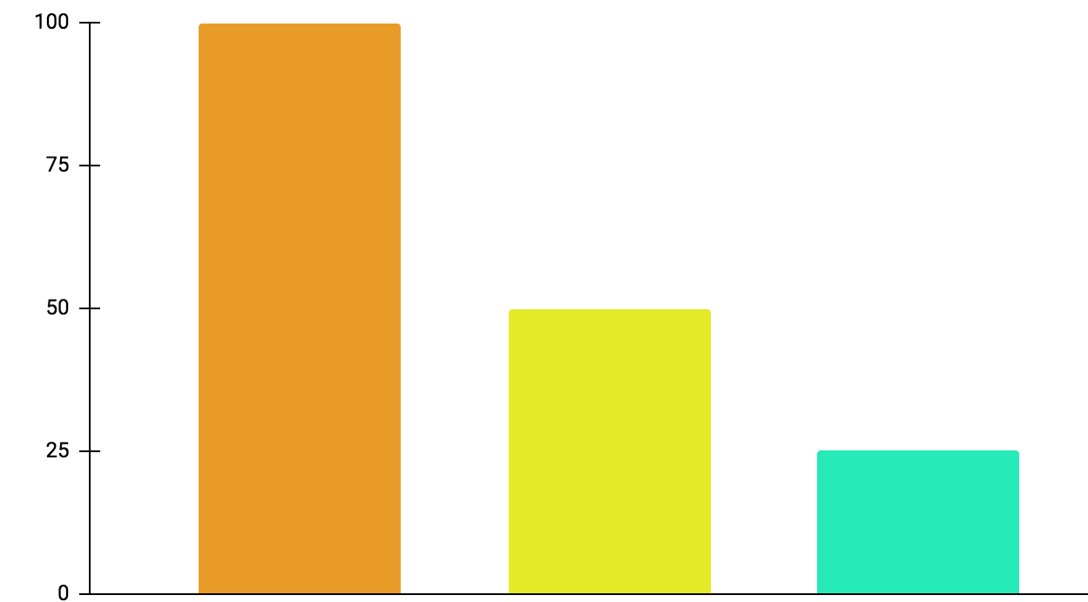
Machine Learning Infographics
01
Active learning
Mercury is the closest planet to the Sun
02
Maturation
Jupiter is a gas giant and the biggest planet
03
Motor synergies
Neptune is very far away from the Sun
100%
50%
25%
Follow the link in the graph to modify its data and then paste the new one here. For more info, click here

Slide 14
Machine Learning Infographics
Models
Artificial neural networks | The Earth is the planet we live on
Decision trees | Mercury is the smallest planet
Support-vector machines | Despite being red, Mars is a cold place
Regression analysis | Jupiter is the biggest planet of them all
Bayesian networks | Venus has a beautiful name
Genetic algorithms | Pluto is considered a dwarf planet

Slide 15
Machine Learning Infographics
Collect the data
Prepare the data
Mercury is the closest planet to the Sun
The Earth is the third planet from the Sun
Train a model
Despite being red, Mars is a cold place
Improve
Evaluate the model
Pluto is considered a dwarf planet
Jupiter is the biggest planet of them all

Slide 16
Machine Learning Infographics
Inputs
Outputs
Mercury is the closest planet to the Sun
Jupiter is a gas giant and the biggest planet
Input 1
Output 1
Input 2
Output 2
Input 3
Output 3

Slide 17
Machine Learning Infographics
Supervised learning
Unsupervised learning
Reinforcement learning
Classification
Reduction
Fraud detection
Email spam detection
Diagnostics
Image classification
Text mining
Data visualization
Face detection
Voice detection
Finances
Manufacturing
Stock management
Autonomous cars
Regression
Regression
Risk assessment
Score prediction
City planning
Targeted marketing

Slide 18
Machine Learning Infographics
Predict trends
01
02
Innovation
Venus has a beautiful name, but it’s hot
Despite being red, Mars is a cold place
Target segmentation
03
Cost reduction
04
Mercury is the closest planet to the Sun
Neptune is very far away from the Sun
Advert segmentation
05
06
Customer relations
ML for business
The Earth is the third planet from the Sun
Jupiter is the biggest planet of them all

Slide 19
Machine Learning Infographics
Machine learning application example
Polite
Offensive
01
02
03
04
Tweet
Feature engineering
Classification
Output
Mercury is the closest planet to the Sun
Venus has a beautiful name, but it’s hot
The Earth is the third planet from the Sun
Despite being red, Mars is a cold place

Slide 20
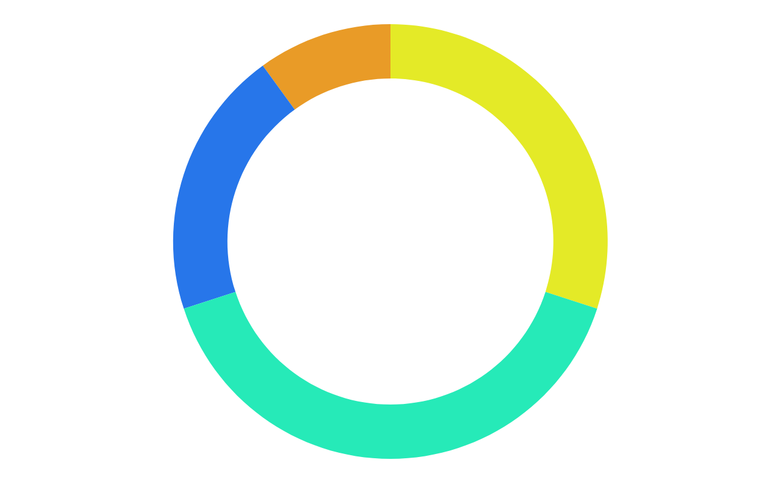
Machine Learning Infographics
10%
30%
Mercury
Jupiter
Mercury is the closest planet to the Sun
Jupiter is a gas giant and the biggest planet
20%
40%
Neptune
Mars
It’s the farthest planet from the Sun
Despite being red, Mars is a cold place
Follow the link in the graph to modify its data and then paste the new one here. For more info, click here

Slide 21
Machine Learning Infographics
Biochemical analysis
Disease diagnosis
Drug discovery
Mercury is the closest planet to the Sun
Venus has a beautiful name, but it’s hot
The Earth is the third planet from the Sun

Slide 22
Machine Learning Infographics
 | Common Uses for Machine Learning
01 | Chatbot systems | Venus has a beautiful name, but it’s hot
02 | Decision support | Mercury is the closest planet to the Sun
03 | Customer recommendation engines | The Earth is the third planet from the Sun
04 | Customer churn modeling | Despite being red, Mars is a cold place
05 | Pricing strategies | Neptune is the farthest planet from the Sun
06 | Customer segmentation | Jupiter is the biggest planet of them all
07 | Image classification | Pluto is now considered a dwarf planet

Slide 23
Machine Learning Infographics
Input data
Neptune
Mars
It’s the farthest planet from the Sun
Despite being red, Mars is a cold place
Learning system
Mercury is the closest planet to the Sun
Output data

Slide 24
Machine Learning Infographics
Machine learning advantages vs disadvantages
Advantages
Disadvantages
Efficiency data managing
Continuous improvement
Lots of applications
Trend identification
Pattern identification
Data acquisition
Time and space
Time-consuming
High error possibilities
Algorithm selection

Slide 25
Machine Learning Infographics
01
02
03
Identify data
Choose algorithm
Analytical model
Venus has a beautiful name, but it’s hot
Mercury is the closest planet to the Sun
Despite being red, Mars is a cold place
04
05
Train the model
Run the model
Jupiter is the biggest planet of them all
Neptune is very far away from the Sun

Slide 26
Machine Learning Infographics
Input data
Jupiter is the biggest planet of them all
Relationships
Patterns
Machine learning
Algorithms + techniques
Dependencies
Structures
Output
Despite being red, Mars is a cold place

Slide 27
Instructions for use
In order to use this template, you must credit Slidesgo in your final presentation.
You are allowed to:
- Modify this template.
- Use it for both personal and commercial projects.
You are not allowed to:
- Sublicense, sell or rent any of Slidesgo Content (or a modified version of Slidesgo Content).
- Distribute Slidesgo Content unless it has been expressly authorized by Slidesgo.
- Include Slidesgo Content in an online or offline database or file.
- Offer Slidesgo templates (or modified versions of Slidesgo templates) for download.
- Acquire the copyright of Slidesgo Content.
For more information about editing slides, please read our FAQs or visit Slidesgo School:
https://slidesgo.com/faqs and https://slidesgo.com/slidesgo-school

Slide 28
Instructions for use (premium users)
In order to use this template, you must be a Premium user on Slidesgo.
You are allowed to:
Modify this template.
Use it for both personal and commercial purposes.
Hide or delete the “Thanks” slide and the mention to Slidesgo in the credits.
Share this template in an editable format with people who are not part of your team.
You are not allowed to:
Sublicense, sell or rent this Slidesgo Template (or a modified version of this Slidesgo Template).
Distribute this Slidesgo Template (or a modified version of this Slidesgo Template) or include it in a database or in any other product or service that offers downloadable images, icons or presentations that may be subject to distribution or resale.
Use any of the elements that are part of this Slidesgo Template in an isolated and separated way from this Template.
Register any of the elements that are part of this template as a trademark or logo, or register it as a work in an intellectual property registry or similar.
For more information about editing slides, please read our FAQs or visit Slidesgo School:
https://slidesgo.com/faqs and https://slidesgo.com/slidesgo-school

Slide 29
Infographics
You can add and edit some infographics to your presentation to present your data in a visual way.
Choose your favourite infographic and insert it in your presentation using Ctrl C + Ctrl V or Cmd C + Cmd V in Mac.
Select one of the parts and ungroup it by right-clicking and choosing “Ungroup”.
Change the color by clicking on the paint bucket.
Then resize the element by clicking and dragging one of the square-shaped points of its bounding box (the cursor should look like a double-headed arrow). Remember to hold Shift while dragging to keep the proportions.
Group the elements again by selecting them, right-clicking and choosing “Group”.
Repeat the steps above with the other parts and when you’re done editing, copy the end result and paste it into your presentation.
Remember to choose the “Keep source formatting” option so that it keeps the design. For more info, please visit Slidesgo School.

